Slide 1
Unit testing in GO
Maciej Norberciak
Test Dive 2024

Slide 2
To test or not to test?
Test!
To see whether it works
To see whether it’s good enough
… unless delivery time firstest
We’ll be talking about automatic unit testing

Slide 3

Notes:
How many gophers out there
How advanced it will be depends on the audience

Slide 4
The protagonist
Go(lang)
Compiled, multi-platform
Multi-paradigm
Statically typed
Garbage collected, memory safe
C-like syntax
Modern
Easy and readable
Notes:
Designed by Google
2012 v1.0
Imperative, functional, object oriented, concurrent programming paradigms are supported (to some degree)
go 25 keywords, java 52 (c++ around 100)
In a nutshell
High level
2 implementations, google I gofrontend for gcc I llvm
Modern, readable, targeting multiprocessors and networking
Efficient in runtime
C like code but better plan 9 dialect inspired

Slide 5
What do we need to support testing?
Just two language features
Eq(x,y)
=
==
===
IF
Notes:
Why to talk about it? Every programming language supports testing, because in order to do it you need
Contitional statement
Equality testing (operator/function)

Slide 6
Test support in programming languages
“Traditional”
Testing is ignored (best case scenario: we have assert)
External library for test support (most likely xyzUnit)
Tests (test code) and test data are wherever in project tree/repository
“Modern”
First class citizen
testing package is a part of standard library
go test tool is a part of standard toolchain
Tests (test code) kept with production code
Notes:
The testing concept is orthogonal to syntax, sematics and pragmatics of language, thus our programming language is testing agnostic
xyzUnit is de facto standard in many languages
Unittest w python or test in ruby also standard library

Slide 7
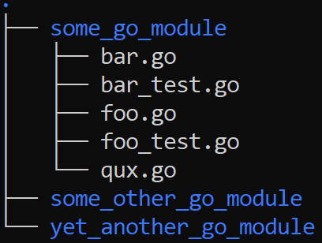
Organization of test code
Production code is organized (top down) in modules, packages and files
Files with test code need to have the same name as production code, plus _test suffix
No physical separation of production and test code
Notes:
Module is a collection of packages

Slide 8
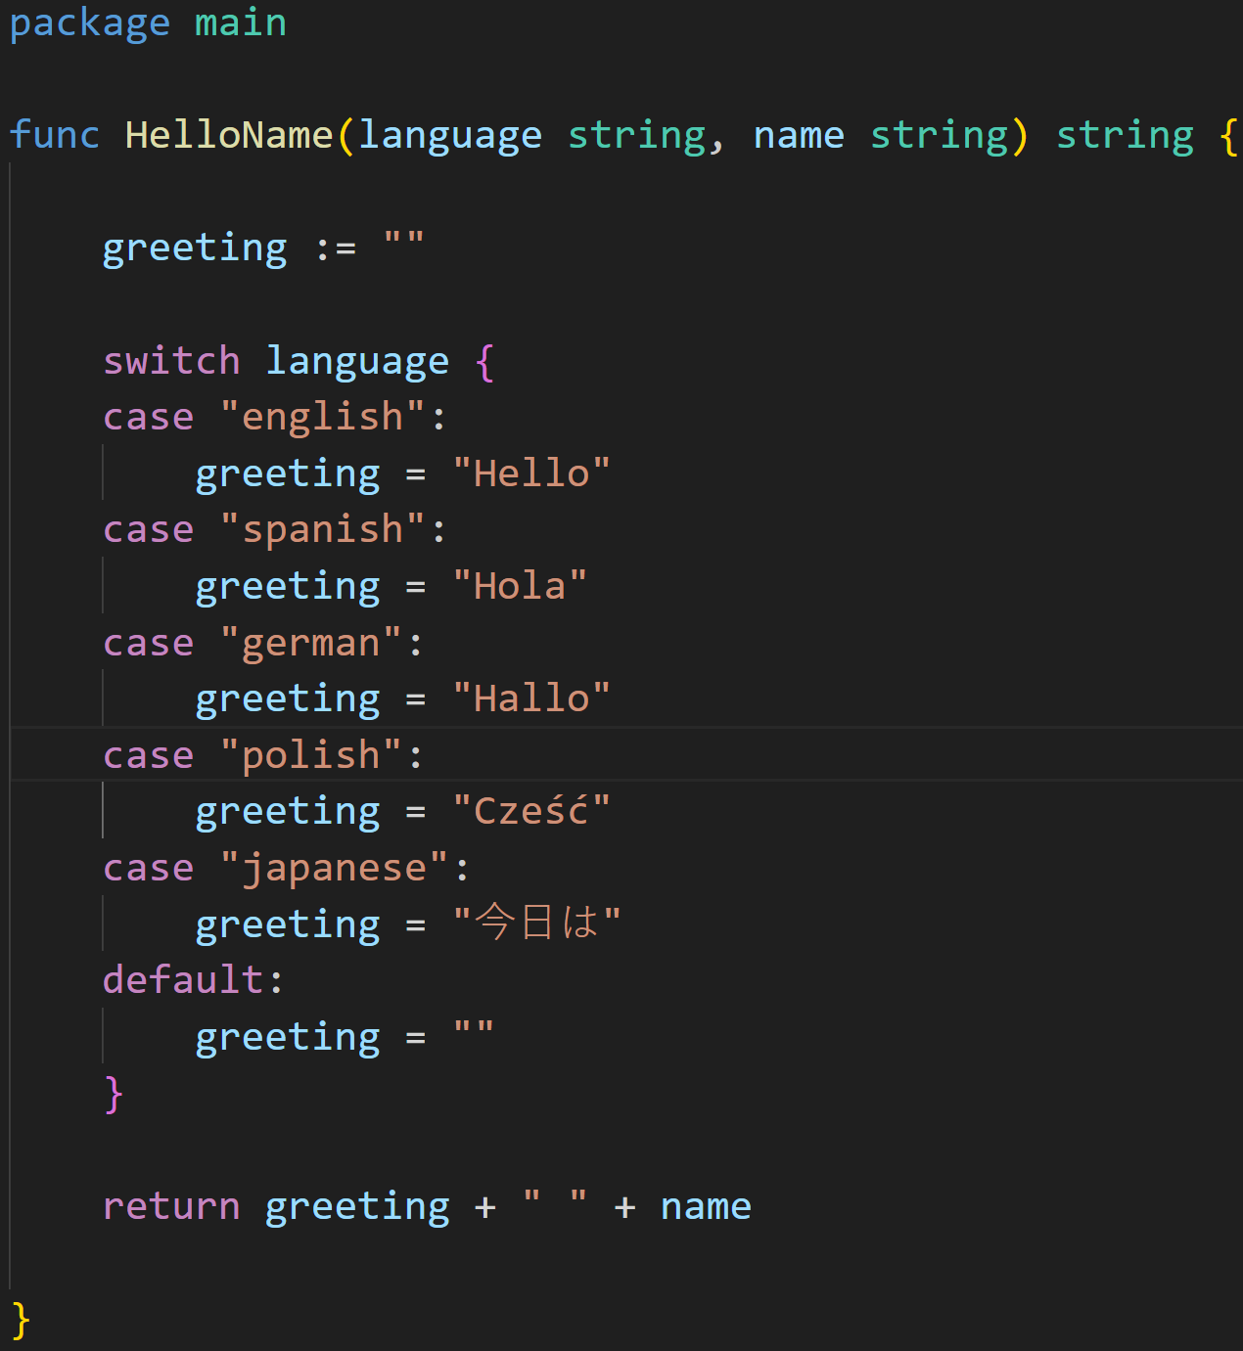
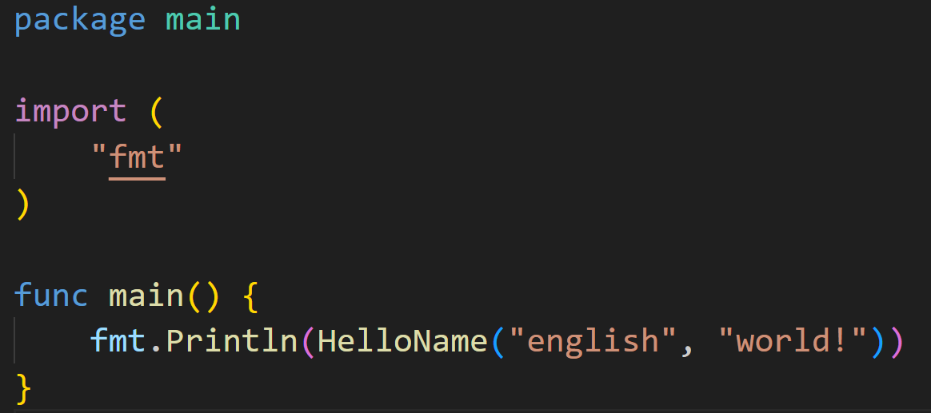

Sample code
Glorified “Hello world”
Notes:
You need to do go run .

Slide 9
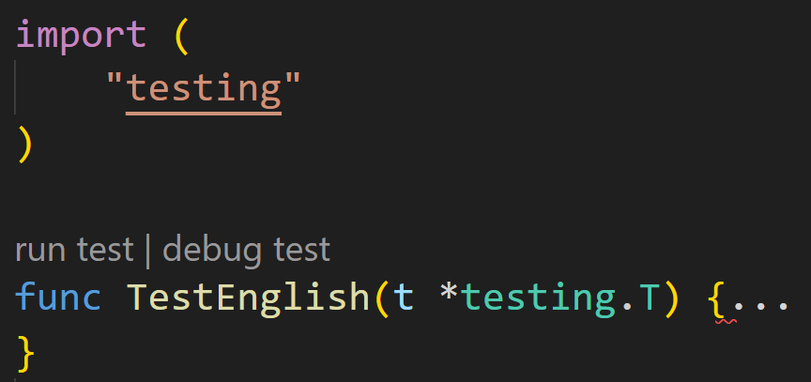
Test code
Boilerplate
Need to import testing package in _test.go file
Each test function name has to start with Test
Each test function has just one parameter – pointer to testing.T structure
Notes:
func TestFoo(t *testing.T) says the function takes a pointer to the the type T in the testing package. T for tests, F for fuzzing, B for benchmarking, etc. That reference is in the variable t.
testing.T stores the state of the test. When Go calls your test functions, it passes in the same testing.T to each function (presumably). You call methods on it like t.Fail to say the test failed, or t.Skip to say the test was skipped, etc. It remembers all this, and Go uses it to report what happened in all the test functions.

Slide 10
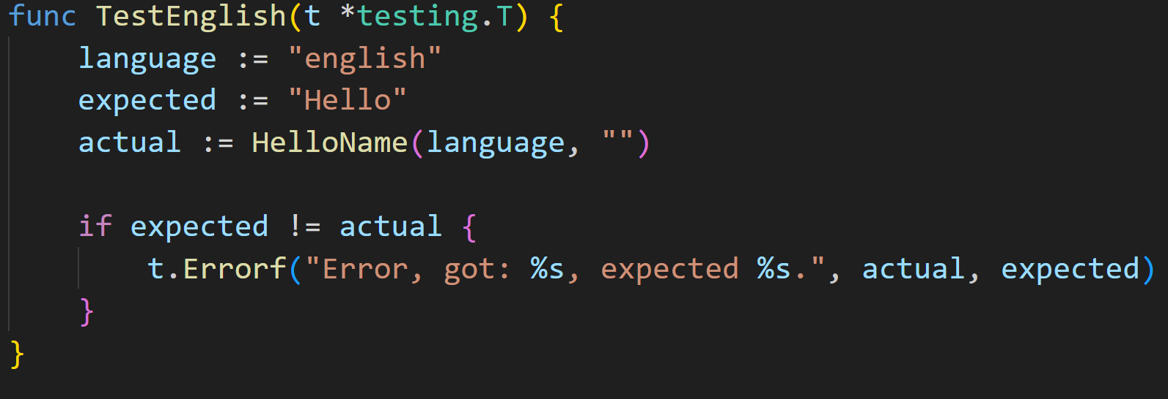
Assertions
No assert function/keyword in Go – need to do it “traditional” way
Notes:
propositional formula is a type of syntactic formula which is well formed. If the values of all variables in a propositional formula are given, it determines a unique truth value
Asercja predykat (forma zdaniowa w danym języku, która zwraca prawdę lub fałsz), umieszczony w pewnym miejscu w kodzie. Asercja wskazuje, że programista zakłada, że ów predykat jest w danym miejscu prawdziwy. W przypadku gdy predykat jest fałszywy (czyli niespełnione są warunki postawione przez programistę) asercja powoduje przerwanie wykonania programu.
go
Sama funkcja testująca, test code, wygląda jak na obrazek Jak widać nie ma jakiejś funkcji assert, więc posługujemy się ifologią. W tym przykładzie mówimy test runtime, że to błąd, Errorf dostaje string i parametry, coś jak printf - to powinno być jak najbardziej opisowe, dobrą praktyką jest też podanie wartości, którą dostaliśmy i oczekiwanej.
Bądźcie deskryptywni, ktoś potem będzie czytał ten kod
W pakiecie testing mamy zestaw różnych failure states, przed chwilą pokazałem t.Error - raportuje, ale kontynuuje wykonanie test suite - mamy 20 przypadków testowych, 3 zgłoszą error, reszta się wykona i potem dostaniecie raport.
t.Fail od razu zatrzyma test suite - ??? todo sprawdzić,chyba tylko fail now to robi, albo fatal, fail zaznacza funkcję jako failed
t.Log po prostu loguje, taki printf
Jest trochę goferów, którzy uważają, że pisanie tych bloków if else jest nieczytelne i rozdmuchuje kod, jest taki moduł testify https://github.com/stretchr/testify który pokarzę na warsztaciei on pozwala pisać asercje - powinno działać na 1.16, chociaż nie jest to explicite powiedziane slajd są całe stosy ludzi, którzy przychodzą z języków z asercjami brzydzi się tymi ifelsami, więc czuję sie w obowiązku pokazać.

Slide 11
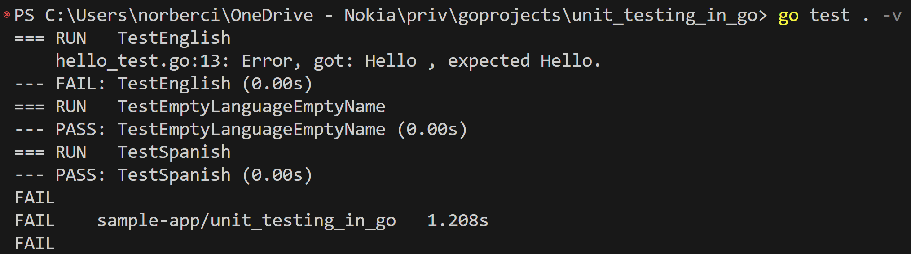
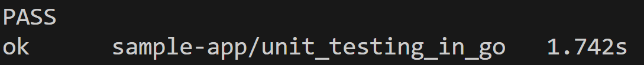
Running tests
Fire & forget, easy to integrate in your CI environment
Notes:
You need to call go test .
Add –v for verbose mode

Slide 12
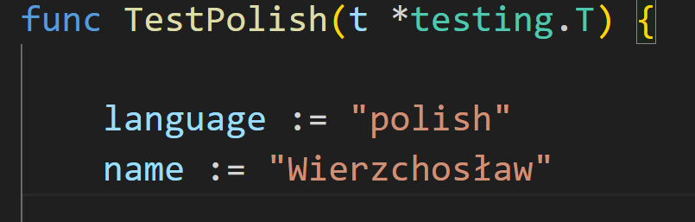
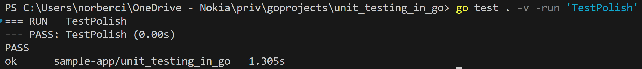
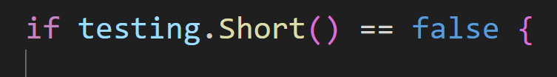
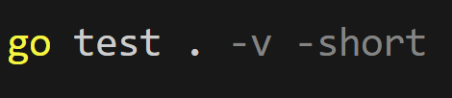
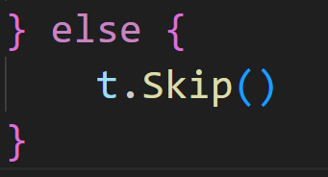
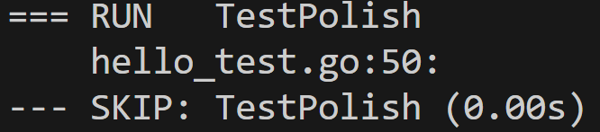
Running some tests
Short tests and run-by-regexp
Notes:
For short tests you need to call go test with –short flag and test the flag in your test code
You can use –run to run some tests – parameter after –run is regexp

Slide 13
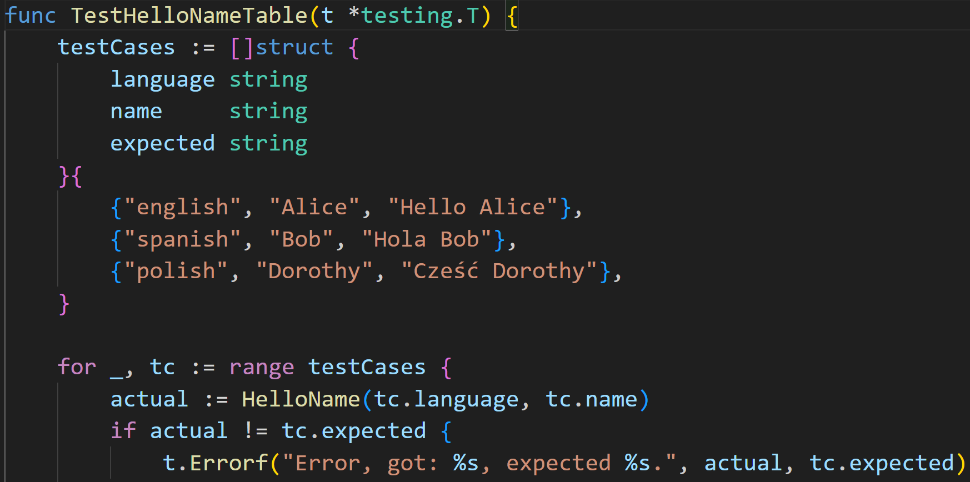
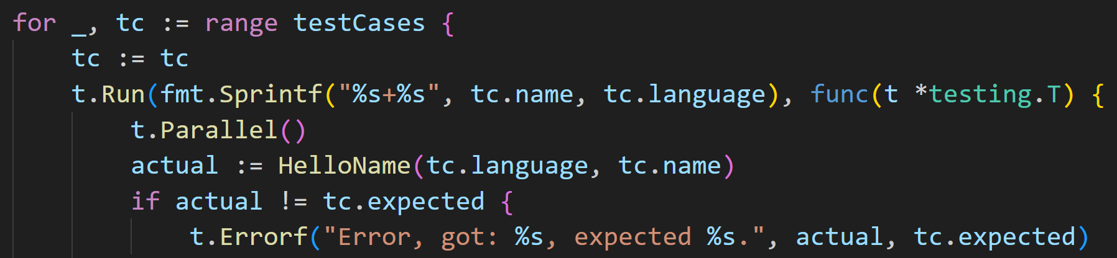
Table driven tests
Subtests and parallelization
Notes:
Instead of copy pastying test code you can put the test data into an array of structures and iterate over it. If you call t.Run each subtest will be done in separate execution thread. t.Parallel tells the toolchain that those subtests can be run in parallel (if the machine has some free cores you can use)

Slide 14
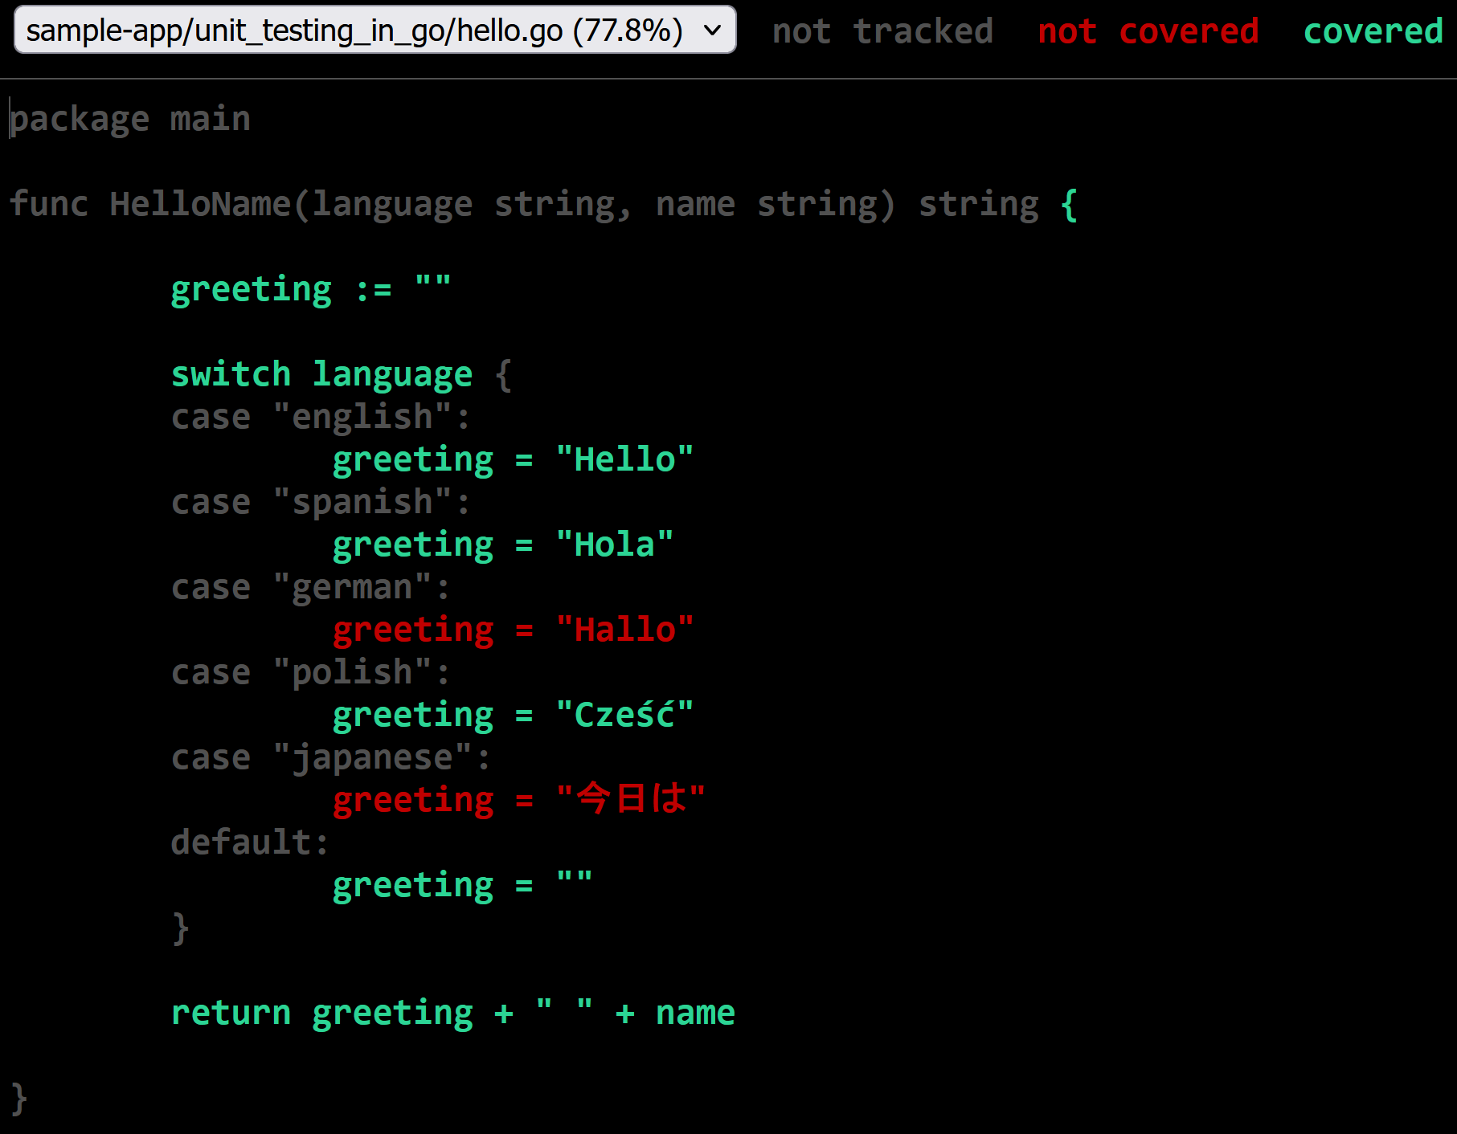
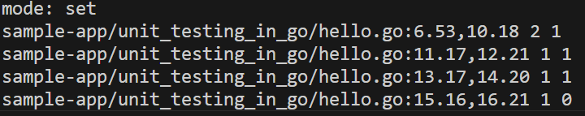
Test coverage
Bare bones
Notes:
Test coverage defines what percentage of application code is tested and whether the test cases cover all the code.. Support is rather bare bones but it works out of the box

Slide 15
More on testing
Test fixture setup and teardown
Externalized test data kept with the source code
Multiple failure states
Deadlines
Shuffling test cases, short/full tests, running some testcases
Fuzz testing
Benchmarks
Subpackages for testing specific functionalities (filesystems, IO, structured logging)
… and more – all in standard library and toolchain

Slide 16

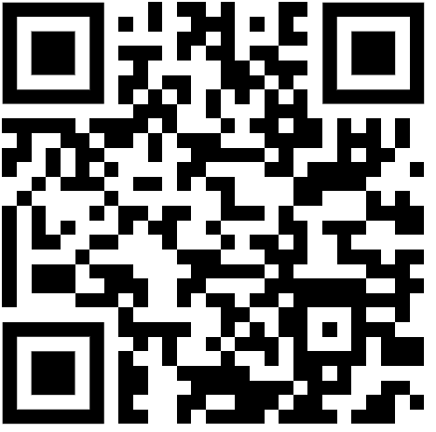
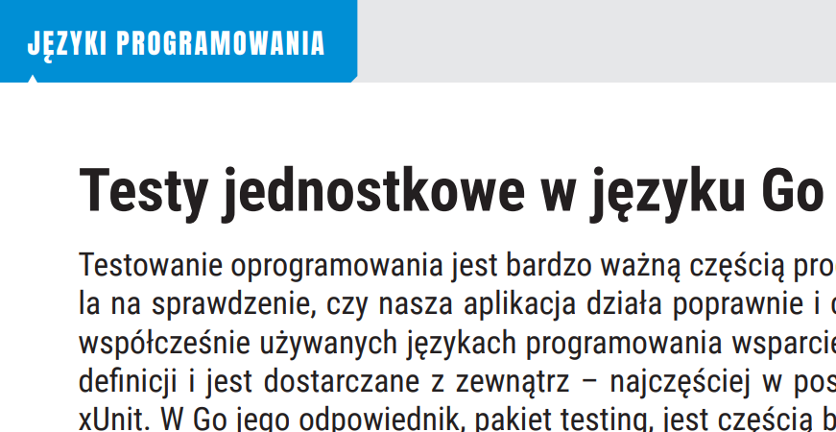
https://github.com/norberci/td2024
Additional materials

Slide 18
Copyright and confidentiality
The contents of this document are proprietary and confidential property of Nokia. This document is provided subject to confidentiality obligations of the applicable agreement(s).
This document is intended for use by Nokia’s customers and collaborators only for the purpose for which this document is submitted by Nokia. No part of this document may be reproduced or made available to the public or to any third party in any form or means without the prior written permission of Nokia. This document is to be used by properly trained professional personnel. Any use of the contents in this document is limited strictly to the use(s) specifically created in the applicable agreement(s) under which the document is submitted. The user of this document may voluntarily provide suggestions, comments or other feedback to Nokia in respect of the contents of this document ("Feedback"). Such Feedback may be used in Nokia products and related specifications or other documentation. Accordingly, if the user of this document gives Nokia Feedback on the contents of this document, Nokia may freely use, disclose, reproduce, license, distribute and otherwise commercialize the feedback in any Nokia product, technology, service, specification or other documentation.
Nokia operates a policy of ongoing development. Nokia reserves the right to make changes and improvements to any of the products and/or services described in this document or withdraw this document at any time without prior notice.
The contents of this document are provided "as is". Except as required by applicable law, no warranties of any kind, either express or implied, including, but not limited to, the implied warranties of merchantability and fitness for a particular purpose, are made in relation to the accuracy, reliability or contents of this document. NOKIA SHALL NOT BE RESPONSIBLE IN ANY EVENT FOR ERRORS IN THIS DOCUMENT or for any loss of data or income or any special, incidental, consequential, indirect or direct damages howsoever caused, that might arise from the use of this document or any contents of this document.
This document and the product(s) it describes are protected by copyright according to the applicable laws.
Nokia is a registered trademark of Nokia Corporation. Other product and company names mentioned herein may be trademarks or trade names of their respective owners.

